Slide 1
Project: Jewellery Scraper

Slide 2
Objective
- Scrape jewellery features to predict the price
- Determine how features affect price value
Libraries used:
Selenium
Pandas
Psycopg2
Sqlalchemy
Website used: goldsmiths

Slide 3
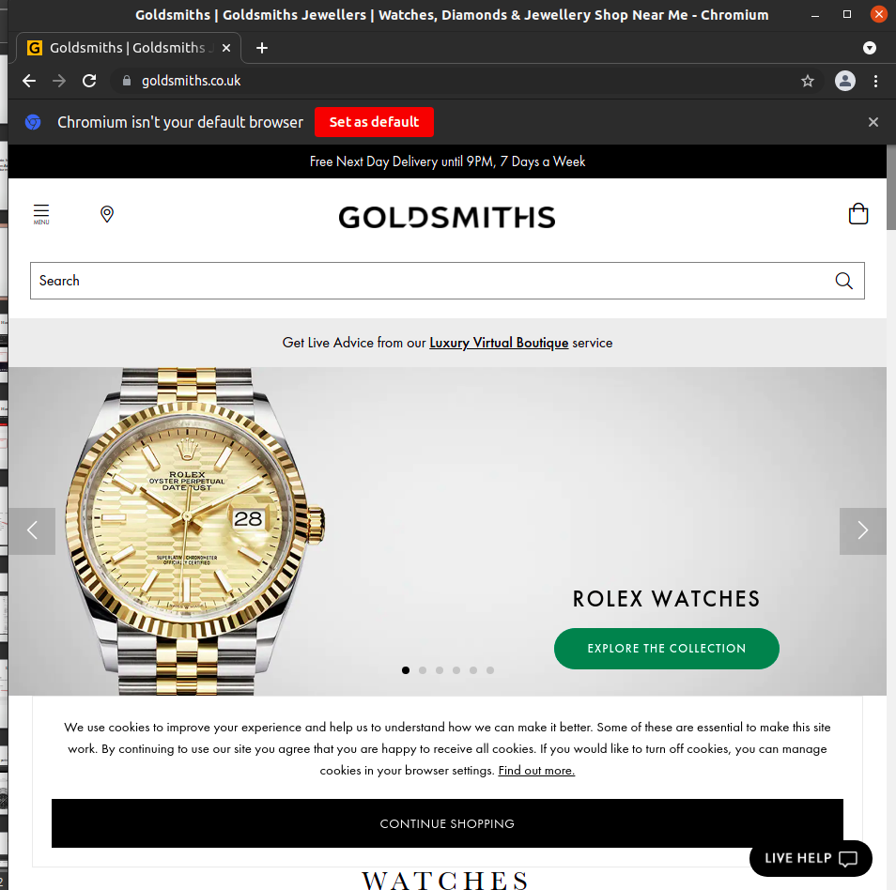
Menu Navigation 1

Slide 4
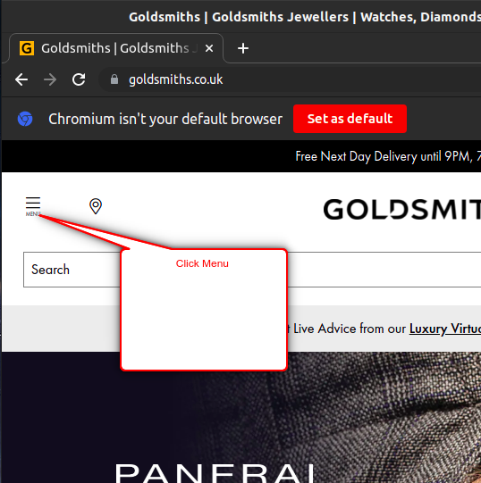
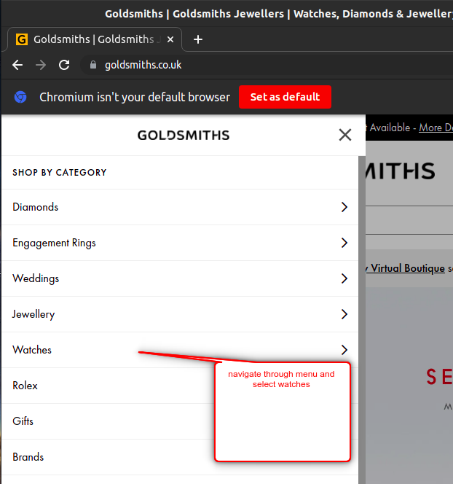
Menu Navigation 2

Slide 5
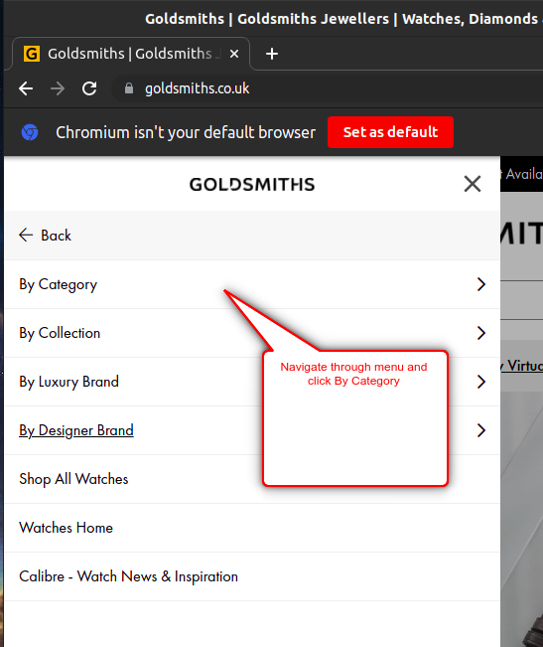
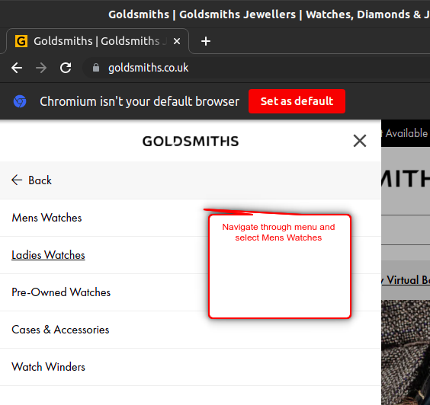
Menu Navigation 3

Slide 6
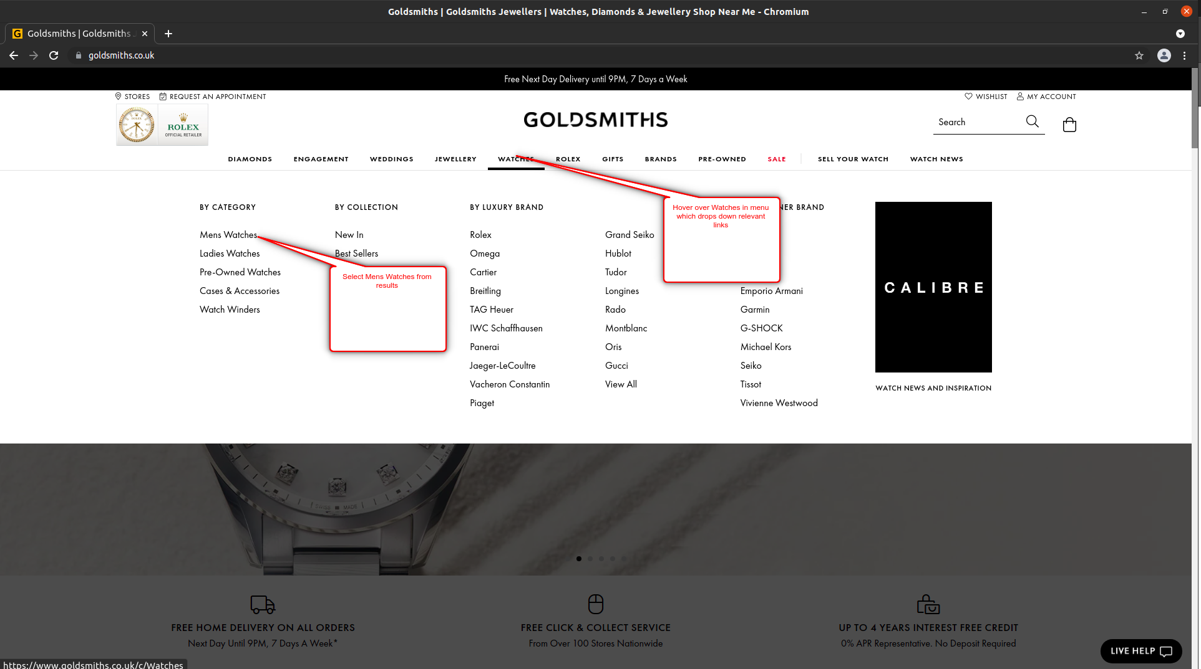
Drop Down Navigation

Slide 7
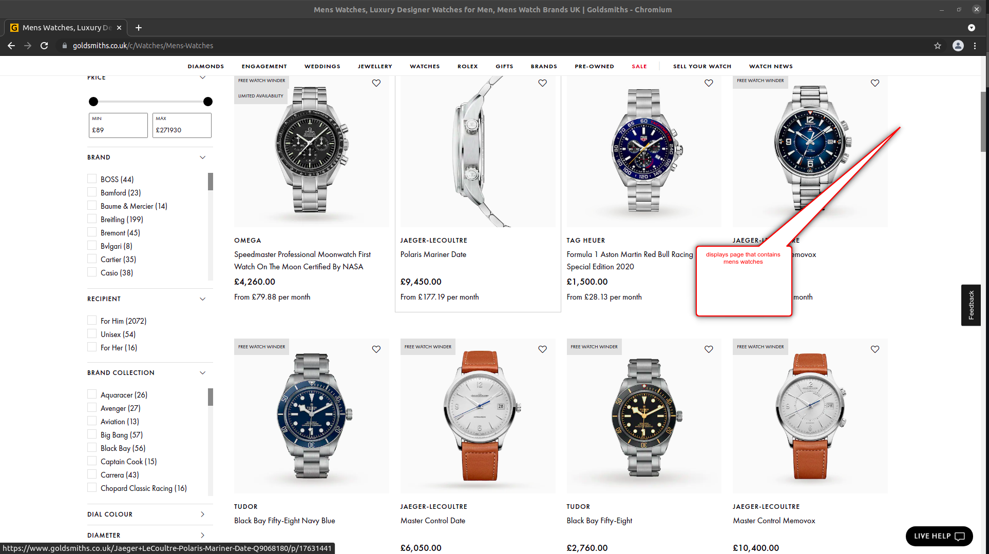
Watch Properties
Grid containing watch properties
List containing watch hyper links

Slide 8
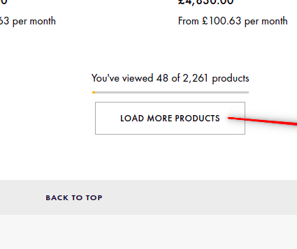
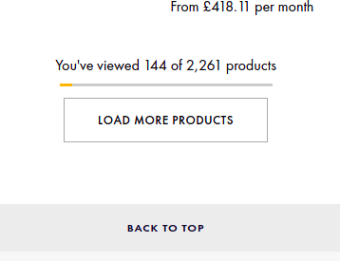
Load products/ Get Links

Slide 9
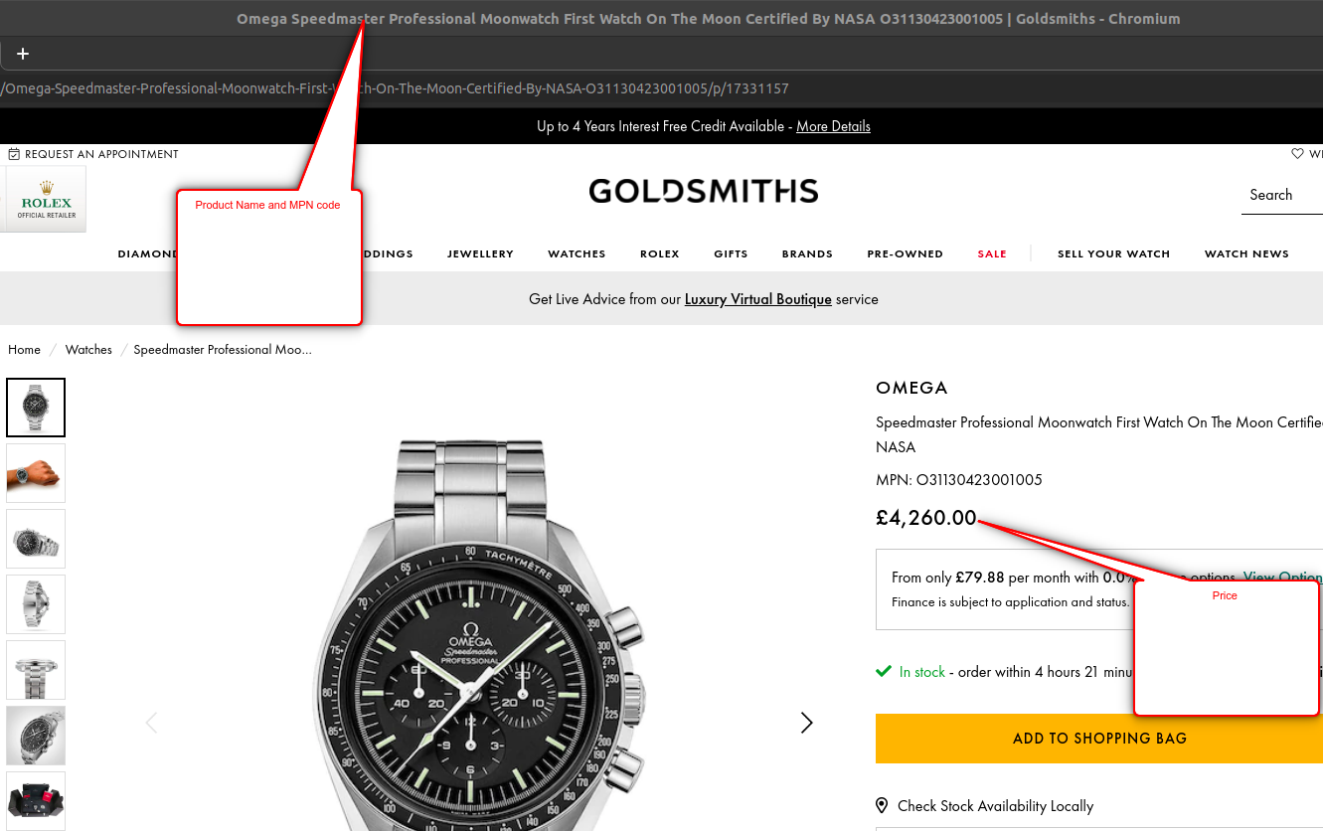
Data - Product Specifications 1
Title/ manufacturer part number
Price

Slide 10
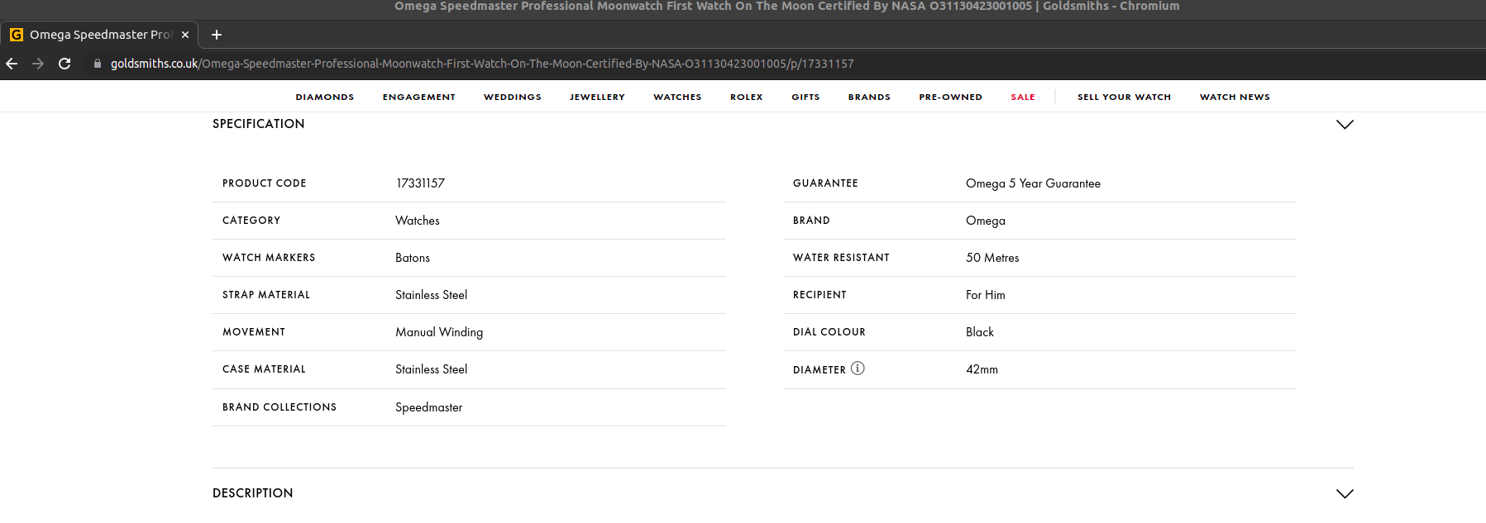
Data - Product Specifications 2

Slide 11
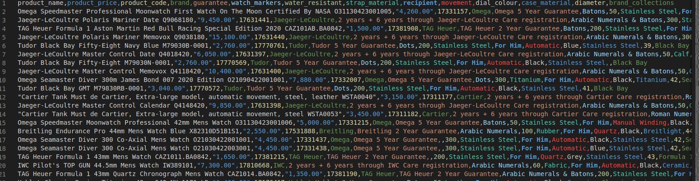
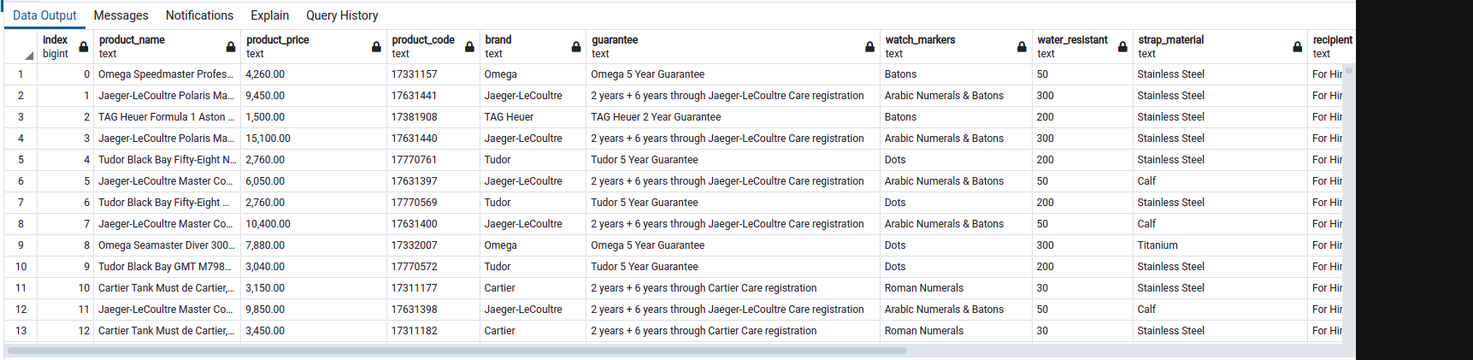
Data Storage

Slide 12
Data Storage

Slide 13
Next Step
Scrape various other jewellery data, which can be used for comparison e.g. rings, bracelets, necklaces etc.
Implement multithreading
Upload to cloud/ remote server

